Slide 1

Blood Bank Management System
A comprehensive solution for managing blood donations, patient requests, inventory, and administrative functions in blood banks.
GROUP MEMBERS:
M USMAN KHAN
RAFI ULLAH
M SARIM KHAN

Slide 2





Key System Features
Donor Management
Register donors with personal details. Track donations and check eligibility.
Patient Management
Store patient information and medical history. Track blood requests and fulfillment status.
Inventory Management
Centralize blood bag data. Get alerts for expiring blood. Manage incoming supplies.
Request Management
Process specific blood type requests. Monitor request status. Prioritize critical needs.

Slide 3
Core Database Structure
Donor Table
Blood Inventory
Patient Table
Blood Request
Stores donor information including DonorID, Name, Age, Gender, BloodType, Contact, Email, and Address.
Tracks available blood with InventoryID, BloodType, Quantity, and ExpiryDate.
Contains PatientID, Name, Age, Gender, Contact, and Address for those needing blood.
Records RequestID, PatientID, BloodType, Quantity, RequestDate, and Status.

Slide 4

Supporting Database Tables
Staff & Operations
Supply Chain
Staff Table: StaffID, Name, Role, Contact, Email, Address
Supplier Table: SupplierID, Name, Contact, Address
Test Table: TestID, DonorID, TestDate, TestResult, StaffID
Supply Table: SupplyID, SupplierID, InventoryID, SupplyDate, Quantity
Appointment Table: AppointmentID, DonorID, StaffID, AppointmentDate
Transactions Table: TransactionID, PatientID, InventoryID, TransactionDate, Quantity
Engagement & Finance
Campaign Table: CampaignID, Name, StartDate, EndDate, Location, StaffID
Feedback Table: FeedbackID, DonorID, PatientID, FeedbackDate, Comments
Payment Table: PaymentID, TransactionID, Amount, PaymentDate, PaymentMethod

Slide 5





Key Relationships
Donor Provides Blood
Donors make donations recorded in Donation table, updating BloodInventory.
Patient Requests Blood
Patients create BloodRequests based on medical needs.
Inventory Fulfills Transactions
Blood from Inventory is used for patient treatments via Transactions.
Staff Manages Operations
Staff perform tests, organize campaigns, and handle appointments.

Slide 6

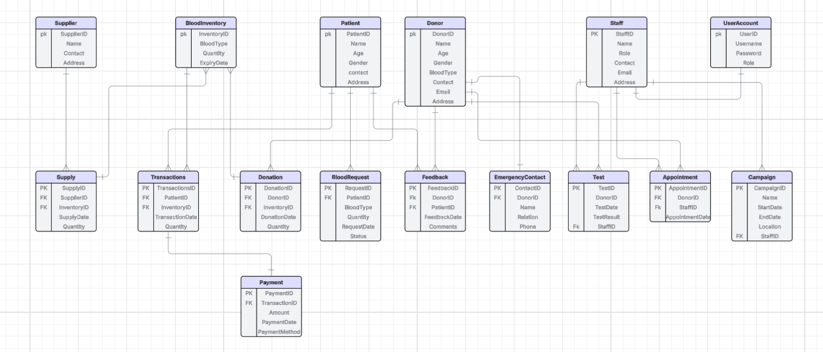
ER Diagram

Slide 7
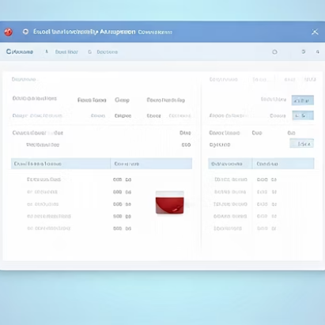



System Actions & Queries
40+
16
24
System Actions
Data Views
Data Operations
SQL queries for viewing, inserting, updating, and deleting records.
Specialized queries for monitoring inventory, requests, and donations.
Functions for adding and modifying system data.

Slide 8




Data Management Operations
View Operations
Query donor data, blood inventory, patient records, and pending requests.
Insert Operations
Add new donors, patients, inventory, requests, staff, and campaigns.
Update Operations
Modify request status, inventory quantities, and staff roles.
Delete Operations
Remove unlinked donors, patients, and suppliers without active records.

Slide 9








Schema Design Decisions
Key Implementation
Normalization
Used primary keys for unique identification and foreign keys for relationships.
Eliminated redundancy and ensured data integrity across tables.
Date Fields
Lookup Tables
Included date tracking for expiration checks and operational timelines.
Simplified data access and updates with specialized tables like BloodInventory.

Slide 10
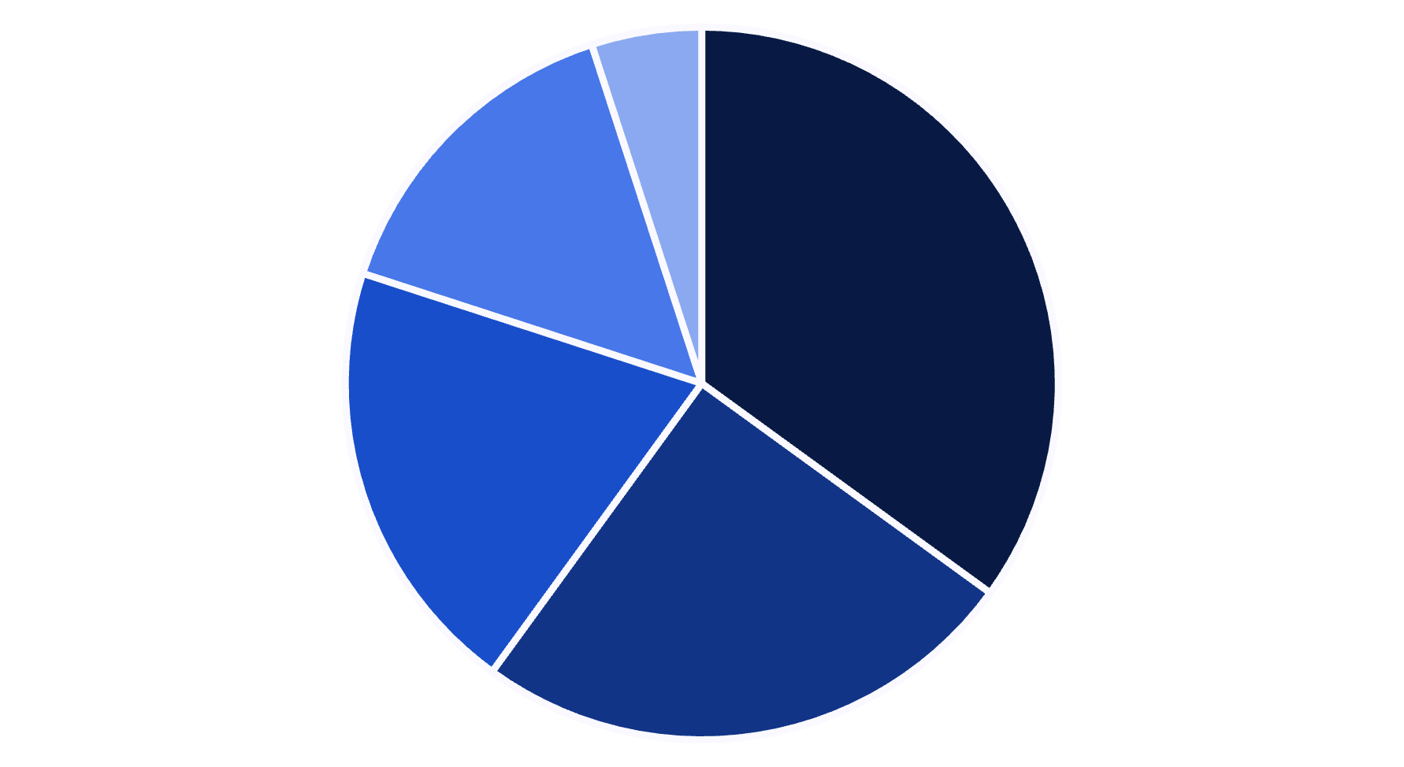
System Benefits
Operational Efficiency
Data Accuracy
Resource Management
Patient Care
Reporting Capabilities
The Blood Bank Management System streamlines operations, improves data accuracy, and enhances resource management. It enables better patient care through efficient blood request processing and provides comprehensive reporting capabilities.

